Slide 1
PEGA Decisioning Essentials

Slide 2
Agenda – Session 7
Configure First Strategy

Slide 3
Configure First Strategy
Now that we have configured the below items.
Configured Context Dictionary.
Imported CAR Data Model.
Imported NBAA Template
Defined Business Structure.
Configured Propositions & their attributes.
Let us look into configuring a basic strategy with simple strategy components.

Slide 4
Strategy Configuration
A Strategy is a critical decisioning module that allows decisioning consultants to configure effective business logic that will result in NBA.
Business Logic can be configured within the strategy using strategy canvas.
It contains of various components.
Strategy Execution happens from left to right.
Generally, the applies-to-class for strategies are configured under SUBJECT class

Slide 5
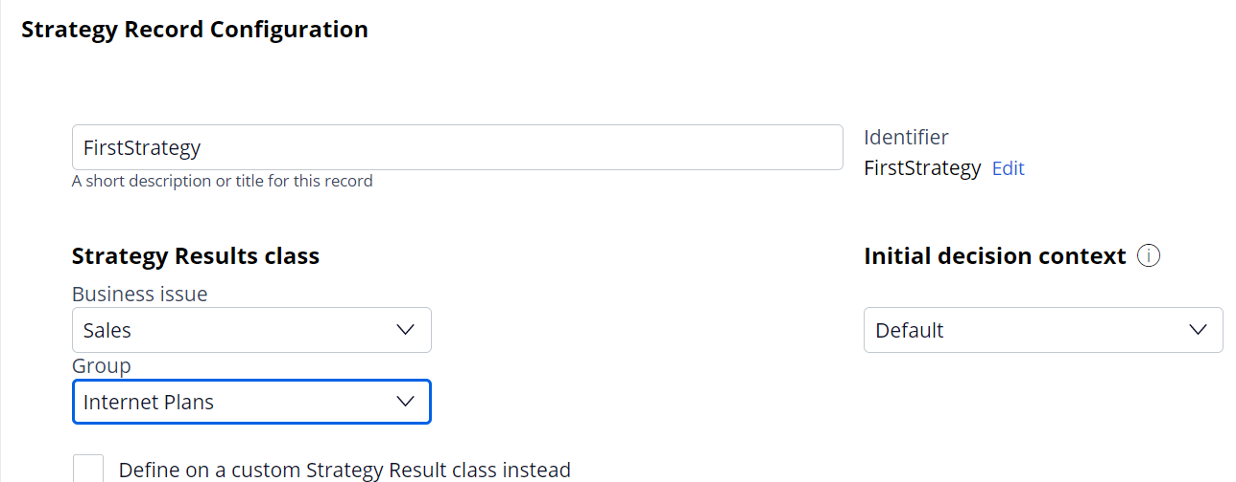
Strategy Configuration
Select the strategy results class from which offers should be sent as input.
For ex, selecting SALES issue and INTERNET PLANS group will only provide propositions within this group in the strategy results. To allow , propositions from all groups and issues, Select NONE.

Slide 6
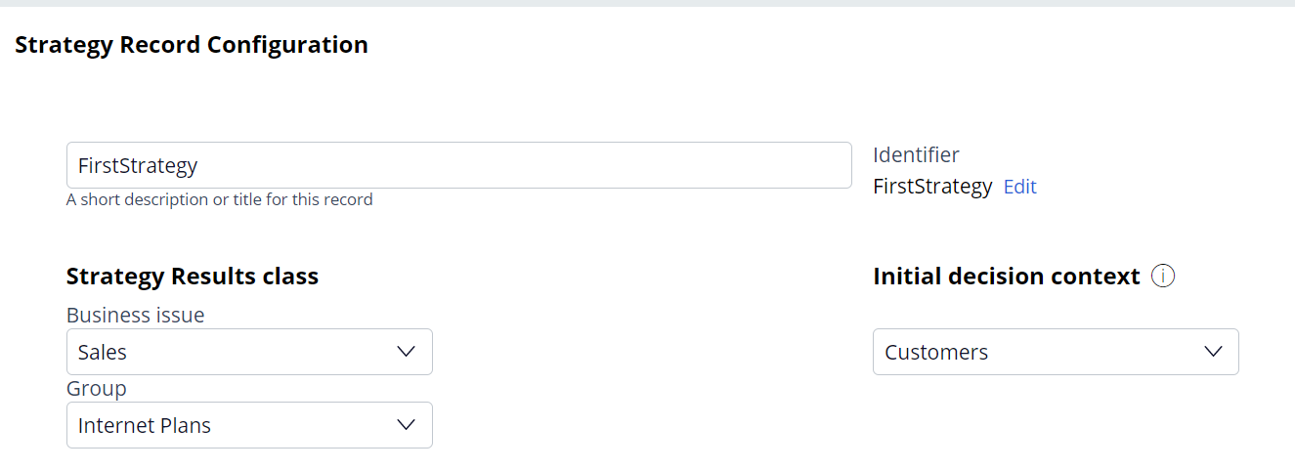
Strategy Configuration
Inorder to make the customer properties ( or the attributes of primary context ) , we can select the initial decision context with the primary context name.
Now , provide the applies to class as primary context class.

Slide 7
Strategy Canvas
By Default, strategy canvas is loaded with the results component which is used to filter out the final results after the logic has been defined
2. Use the mini map to adjust the canvas coverage.
3. Turn on the PAN Mode to easily move along with the strategy canvas
By switching off the select mode

Slide 8
Strategy Canvas
Lets examine the below simple scenarios this session
Importing Propositions
Filtering Propositions
Setting Attributes.
Using Annotations
Using Switch Component
Using Champion Challenger
Using Prioritize Component
We also be covering how do we test the strategies using customer persona.
2. Now , provide the applies to class as primary context class.

Slide 9
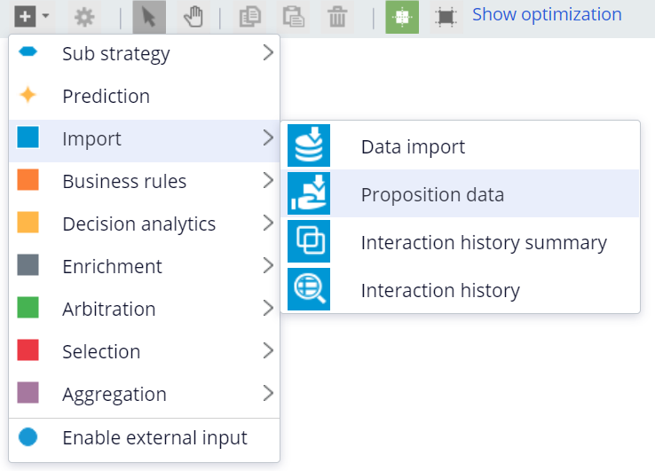
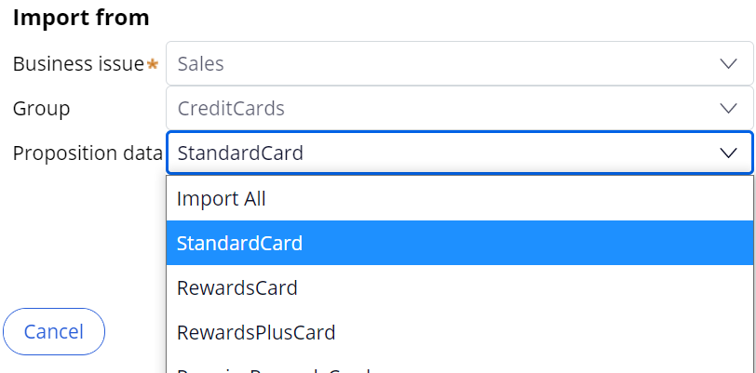
Importing Propositions
Inorder to promote offers through the strategy logic and derive the next best action,
We need to import the propositions.
We could do the same by using import proposition data component
b. Now , double click and import the offers from specific group/issue or a specific proposition.
Notice the options is determined by the strategy results classes selected while creation

Slide 10
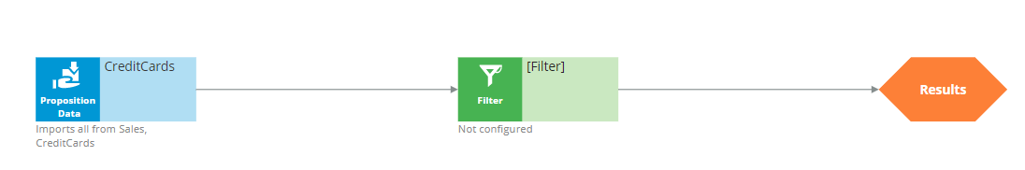
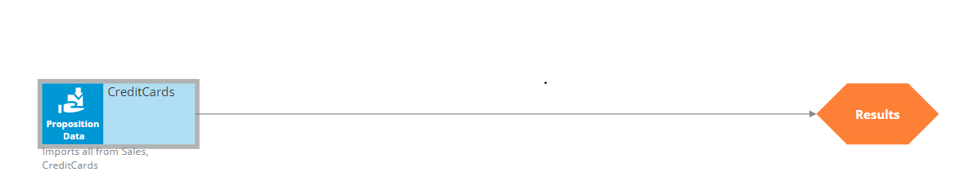
Filter Shape
Within the connected strategy components, Let us include a filter component which used to filter the results based on condition.
Use a filter
Use a proposition filter (advanced)

Slide 11
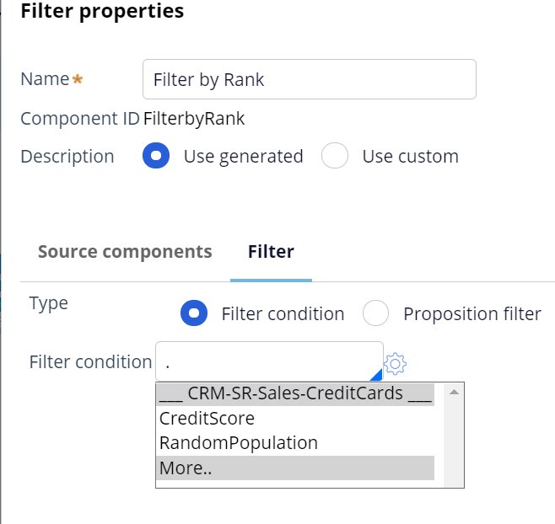
Filtering Propositions
We can provide an conditions based on custom attributes or Customer attributes,
For example, such as
Filter only the propositions who need minimum
Customer income as 10000
Or
Filter only the propositions whose
Sale price is below 500

Slide 12
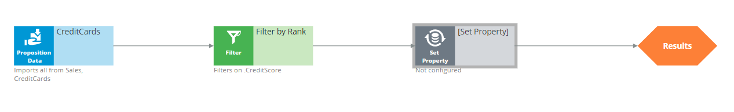
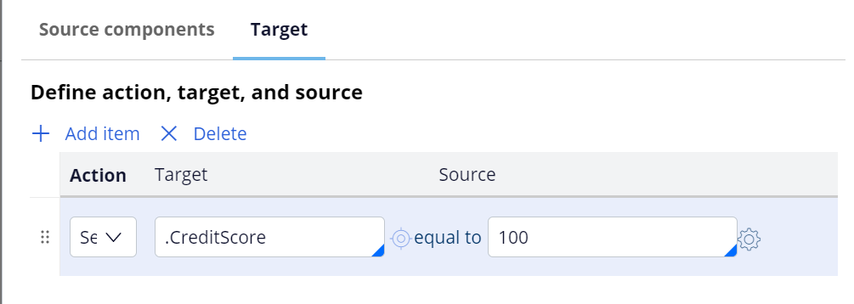
Setting Property Value
A Set Property Component is used to easy to set or override the value of a SR attribute into the strategy results.
For ex, lets set the credit score as shown below and run the strategy.

Slide 13
Setting Property Value
A Set Property Component is used to easy to set or override the value of a SR attribute into the strategy results.
For ex, lets set the credit score as shown below and run the strategy.

Slide 14
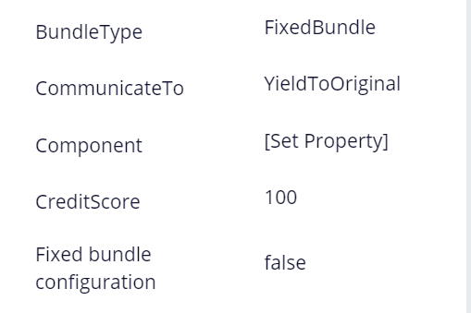
Executing Strategy
A Strategy can be executed by clicking on < icon in 2 ways.
Single Case
Batch Decisioning
Single Case execution is executing a strategy on a single customer.
Batch Decisioning execution is executing a strategy on multiple customers.
Lets run the strategy and observe results
Notice the SR property set with the static
Value used in set property component

Slide 15
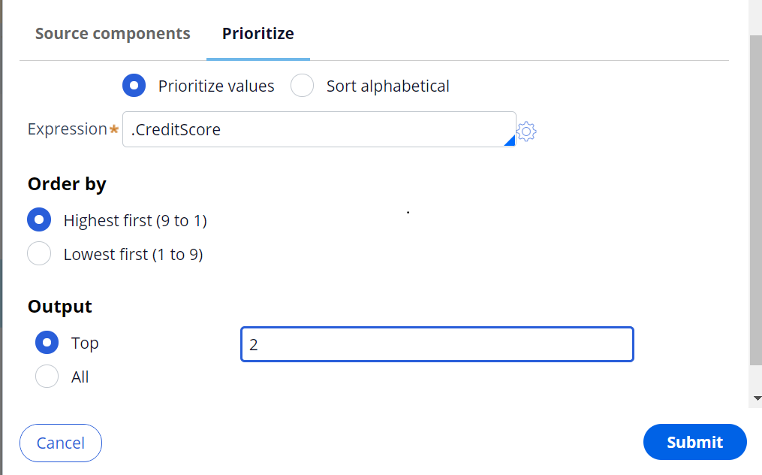
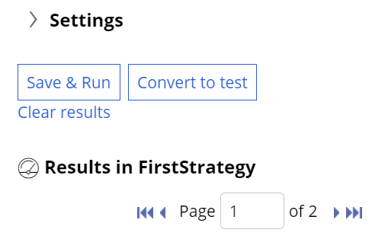
Prioritization
A Prioritization Component plays crucial role in sorting or rearranging the propositions with best offer(s) before resulting into the strategy results
We can output all the prioritized offers or top N prioritized offers as shown below.
Notice we prioritized the propositions propositions based on credit score and and output only top 2. So we received only 2 results.

Slide 16
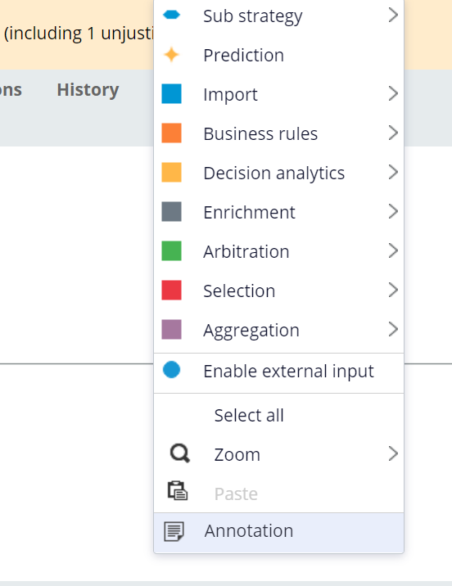
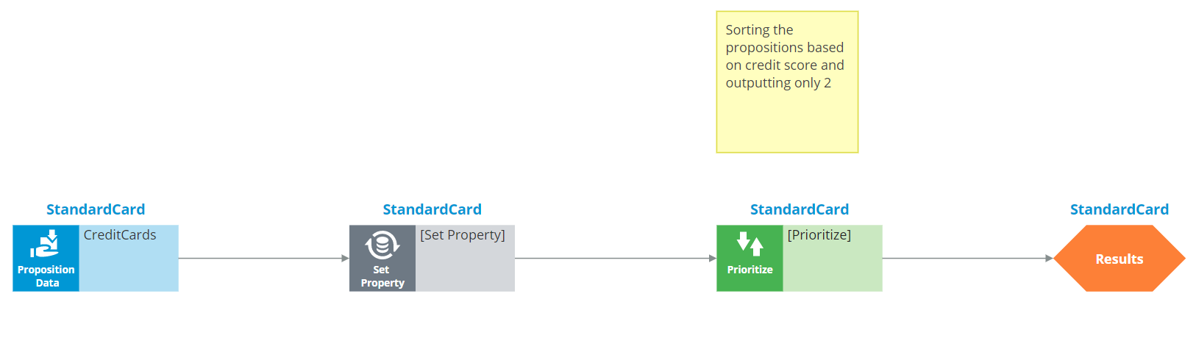
Annotation
Annotations are relevant comments placed by consultants in order to better explain the logic configuration for demonstration for future purposes.

Slide 17
Questions!

